Slide 1
Encryption
CYB101
Unit 2

Slide 2
Welcome to Unit 2: Encryption
Turn on your camera
Rename yourself with your pod number and full name:
6 - Montero Hill
Answer the question below in the chat:
What piece of tech do you wish you could instantly invent?
Notes:
TF Support Person Instructions: Add these directions listed in italics into the Chat.
Find your pod number here! https://courses.codepath.com/courses/cyb101/pages/groupings

Slide 3





As a community, we will...
Be present, physically and mentally
Actively build an inclusive community and space
Practice curiosity and adopt a learning mindset
Ask for help when we need it
Keep our cameras on

Slide 4
1 | Intro | 00:00 - 00:05
2 | Ciphers & Hashing | 00:05 - 00:25
3 | Key Encryption | 00:25 - 00:35
4 | Secure Sockets Layer | 00:35 - 00:45
5 | Lab: Your Kali Machine | 00:45 - 01:55
6 | Wrap Up | 1:55 - 2:00

Slide 5
Ciphers & Hashing
20 minutes
Notes:
TF Support Person Instructions: Add these directions listed in italics into the Chat.
Add your questions here!
https://docs.google.com/spreadsheets/d/1ykYYJnWEXYqCsO5XlVv6IxtmvapTAtdMcjpdHKH3Xf0

Slide 6
What is encryption?
The process of converting data into a code
Used to prevent unauthorized access
Decrypting becomes an extra step a bad actor must take once they obtain data
Can be traced back to ancient civilizations
Egypt, Greece, Italy

Slide 7
Substitution Ciphers
Substitute one character for another
Can include symbols, numbers, letters, etc.
Reversible
Examples: Caesar cipher, Vernam cipher, ROT-1

Slide 8
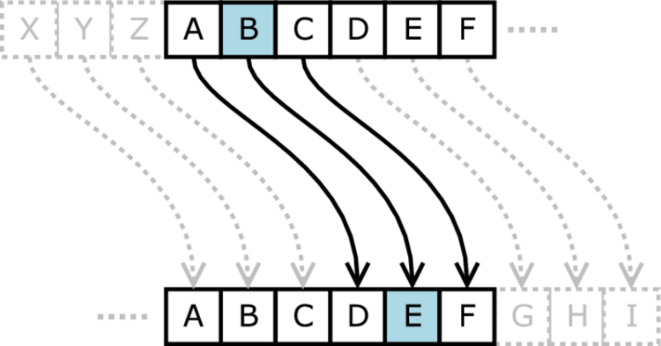
The Caesar Cipher
A → D
B → E
C → F
D → G
etc.

Slide 9
3 minutes
Encrypt the following message using the Caesar Cipher with a shift of 3:
hot kebab
Notes:
Answer: krw nhede

Slide 10
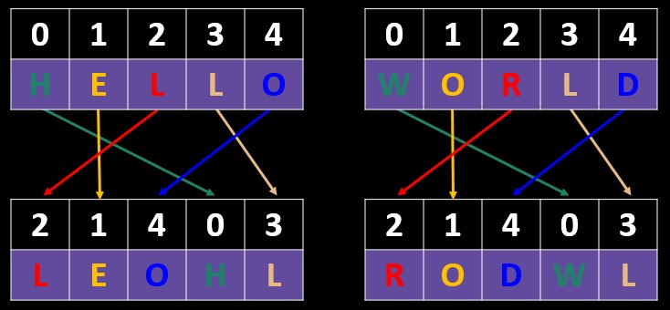
Transposition Ciphers
Encrypt text by moving pieces of the message around
Think: anagrams
Plain Text
Cipher Text

Slide 11
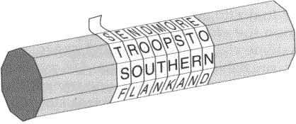
Ancient Transposition Cipher: Scytale
Parchment was wrapped around a cylinder
Message made no sense when unwrapped and read downwards

Slide 12
These ciphers are useless
Modern methods make substitution and transposition ciphers obsolete
Still helpful for understanding how data is encrypted

Slide 13
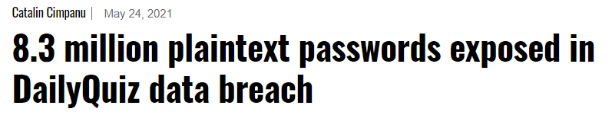

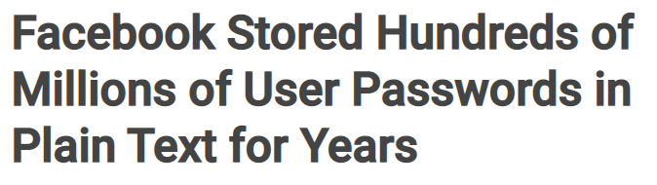
Now you know plaintext passwords are inexcusable...

Slide 14
Hashing
Transforming a given string of characters into another value
Involves performing a non-reversible algorithm on data
Results in a fixed-length output
Extremely computationally complex to brute force
Deterministic: same message results in same hash
Notes:
TF Support Person Instructions: Add these directions listed in italics into the Chat.
Add your questions here!
https://docs.google.com/spreadsheets/d/1ykYYJnWEXYqCsO5XlVv6IxtmvapTAtdMcjpdHKH3Xf0

Slide 15
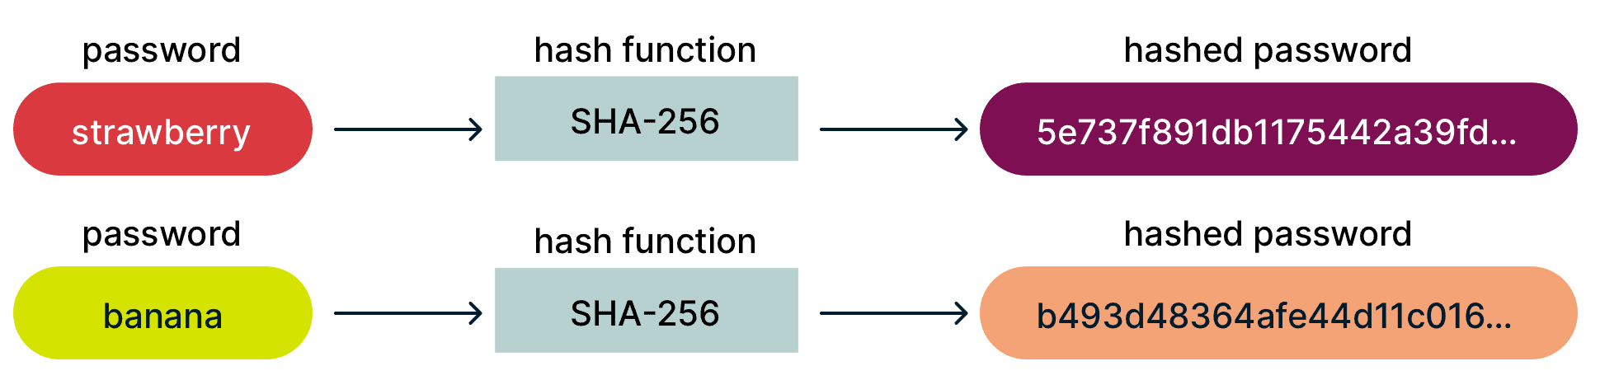
Hashing Algorithms
Many in common use
MD5, SHA-1, SHA-2, NTLM, LANMAN

Slide 16




How Hashing Works: Account Creation
User enters password in plain text
Platform uses an algorithm to create hash
Platform stores only the hash
75c0e6dd7f2bc49889eea8736b866590d1046573
SPICY-p3pp3r$
SHA-1
(example)

Slide 17
How Hashing Works: Login
User enters password in plain text
Platform uses an algorithm to create hash
Platform checks new hash against stored hash
75c0e6dd7f2bc49889eea8736b866590d1046573
SPICY-p3pp3r$
SHA-1
(example)

Slide 18
Key Encryption
10 minutes

Slide 19
Encryption Keys
A random string of bits generated specifically to scramble and unscramble data
Designed to be unique and unpredictable

Slide 20
Symmetric-Key Algorithms
Only one key is used to both encrypt and decrypt the data
Requires the key to be exchanged
Sometimes called “secret” encryption key
If the key was public, data could be decrypted by anyone

Slide 21




Symmetric-Key Algorithms Visualized
Original message
Encrypted message
Original message
Key
Key

Slide 22
Symmetric Key Algorithms Visualized
Original message
Encrypted message
Original message
Key
Key
Identical key used

Slide 23
Asymmetric-Key Algorithms
Often called public-key encryption
Pairs of related keys are used to encrypt and decrypt data
One private, one public
Cannot calculate private key from public key

Slide 24
Public and Private Keys
Public key is known to all, used to send messages
Private key is only known by the receiver
Example: a journalist receiving secret messages from sources
Public key allows anyone to send an encrypted message
Private key allows only the journalist to decrypt messages
Notes:
TF Support Person Instructions: Add these directions listed in italics into the Chat.
Add your questions here!
https://docs.google.com/spreadsheets/d/1ykYYJnWEXYqCsO5XlVv6IxtmvapTAtdMcjpdHKH3Xf0

Slide 25

Asymmetric Key Algorithms Visualized
Original message
Encrypted message
Original message
Recipient's public key
Recipient's private key

Slide 26
Symmetric vs. Asymmetric Cryptography
Both are in use today
Symmetric-key encryption advantages
Tends to be faster
Asymmetric-key encryption advantages
More secure
Avoids key transmission

Slide 27
2 minutes
What is the difference between the public and private keys in asymmetric-key encryption?
Notes:
Answer: the public key is shared widely and used to send messages to the receiver. the private key is used to decrypt messages and is typically only known by the publisher

Slide 28
Secure Sockets Layer
10 minutes

Slide 29
Secure Sockets Layer (SSL)
A protocol for encrypting, securing, and authenticating communications that take place on the Internet
Protocol: set of rules, not a specific procedure
Commonly used to secure client-server communications
Also email, VoIP, etc.
Uses both symmetric- and asymmetric-key encryption

Slide 30
SSL Certificates
Digital document that validates a website’s identity
Essentially a set of public keys for a server
Signed SSL: a trusted authority has issued the certificate

Slide 31


Step 0: Certificate Verification
Client requests SSL certificate from server
Client uses public key to verify the certificate
Client
Server
Client has:
public key for server
Server has:
public key for server
private key for server

Slide 32
Step 1: TLS Handshake
Client generates symmetric keys to use only during this session
Client secures the symmetric key using the public key
Client sends symmetric key to server
Client
Server
Client has:
public key for server
symmetric key
Server has:
public key for server
private key for server

Slide 33
Step 2: Key Decryption
Server receives the symmetric key from the client
Server decrypts the symmetric key using the private key
Client
Server
Client has:
public key for server
symmetric key
Server has:
public key for server
private key for server
symmetric key

Slide 34
Step 3: Data Exchange Continues
Client and server can now communicate securely by encrypting/decrypting messages with the symmetric key
Client
Server
Client has:
public key for server
symmetric key
Server has:
public key for server
private key for server
symmetric key

Slide 35
Break Time!
Take 5 mins to step away from the computer. Feel free to turn off your camera and return promptly after 5 mins.
Notes:
TF Support Person Instructions: Add these directions listed in italics into the Chat.
Have fun! See you in 5 minutes. ✌️

Slide 36
Lab: Your Kali Machine
70 minutes
Notes:
TF Support Person Instructions: Add these directions listed in italics into the Chat.
Find your Unit 2 lab here! https://courses.codepath.org/courses/cyb101/unit/2#!labs

Slide 37
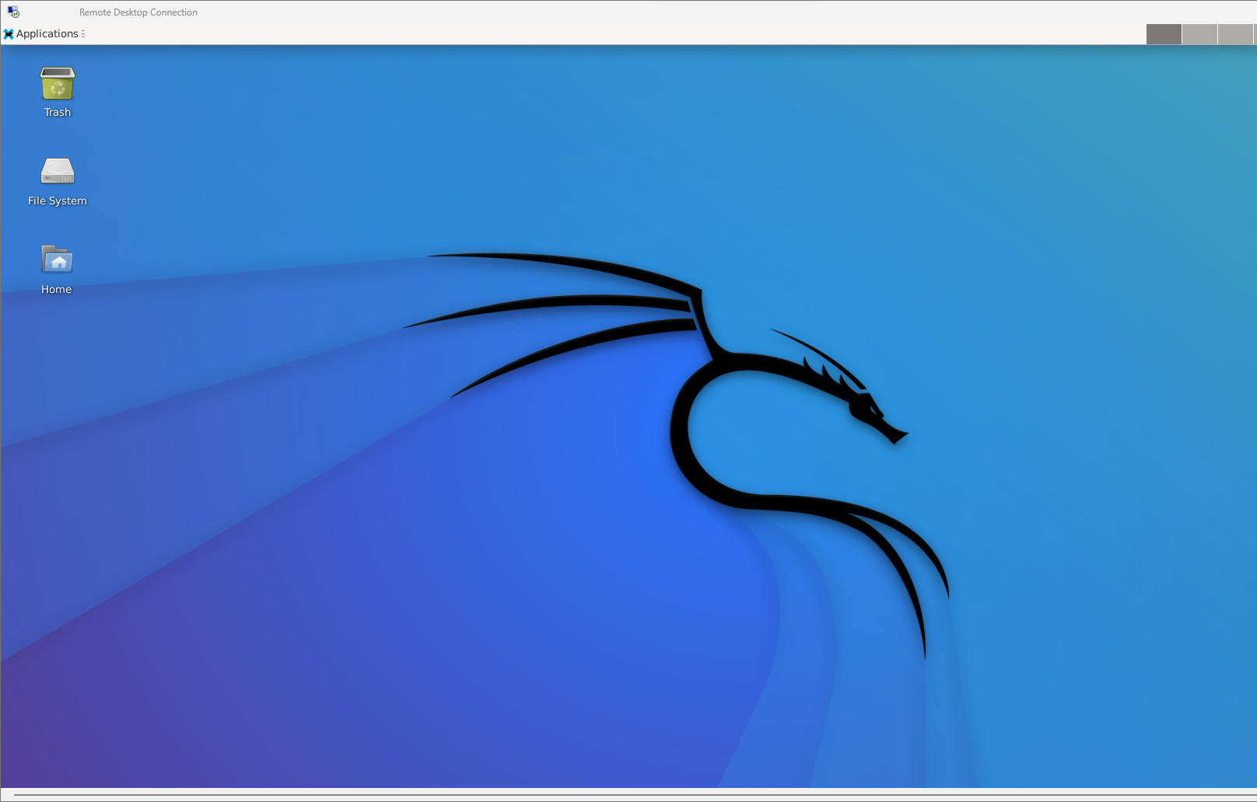
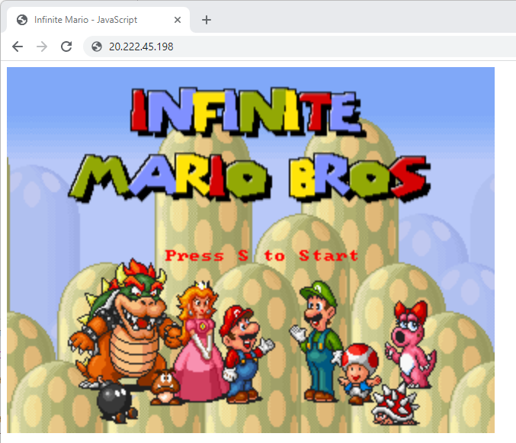
Lab: Your Kali Machine

Slide 38
Project Preview: All About SSH Keys
Generate public and private keys
Use these keys in a variety of ways
SSH to Kali
Message signing/encrypting

Slide 39
65 minutes
Navigate to the Lab tab in the course portal
Complete the Unit 2 Lab: Cloud VM Web Server!
@[handle]
Notes:
Set Slack handle to @cyb101-s1-help-spring23 OR @cyb101-s2-help-spring23

Slide 40
Wrap Up
5 minutes

Slide 41
Before you leave...
Complete the Session Survey (5 minutes)
Reminder: complete the Project before next session!
Next session: Authentication 🔑
Notes:
TF Support Person Instructions: Add these directions listed in italics into the Chat. Leave your feedback here! https://forms.gle/7jE9W5cfjowadk7C7

